Slide 1
Exempted Sectors in Free Trade Agreements
Alan V. Deardorff Rishi Sharma
University of Michigan Colgate University
For presentation at
Australasian Trade Workshop
RMIT, Melbourne
March 24, 2019

Slide 2
Exempted Sectors
These are sectors that retain positive tariffs within an FTA
These are more common than I once supposed

Slide 3
Exempted Sectors
GATT/WTO requires only that
tariffs be eliminated on “substantially all the trade between the constituent territories on products originating in such territories.”
(Note “originating.” This raises the important issue of Rules of Origin, which I will not address here.)

Slide 4
Exempted Sectors
Why I expected them to be a concern:
Most likely to be sectors most vulnerable to competition from imports
Thus I called them “sensitive sectors”
These are sectors most likely for trade creation
Exclusion of sensitive sectors
Reduces trade creation, while
Retaining trade diversion
Thus I thought that exempting sectors was likely to make FTAs welfare-worsening

Slide 5
Exempted Sectors
In this paper we look in the data for a correlation between
Exempted sectors
Trade creation relative to trade diversion
We find it,
But only for developed countries
Correlation is opposite for developing countries
Motivation for exempting sectors seems to differ by income

Slide 6
Exempted Sectors
Why might low income countries exempt trade diverting rather than trade creating sectors?
Two potential reasons:
Concern for tariff revenue losses (c.f. Fontagné et al., 2010)
Less bargaining power
We find some evidence in favor of both of these reasons

Slide 7
Outline
Model
Equations
Graph
Data
Results

Slide 8
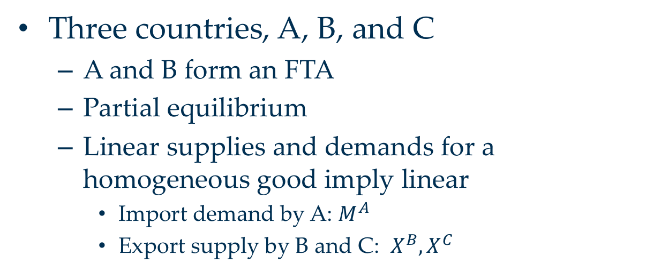
Model
Three countries, A, B, and C
A and B form an FTA
Partial equilibrium
Linear supplies and demands for a homogeneous good imply linear
Import demand by A: $M^{A}$
Export supply by B and C: $X^{B}, X^{C}$

Slide 9
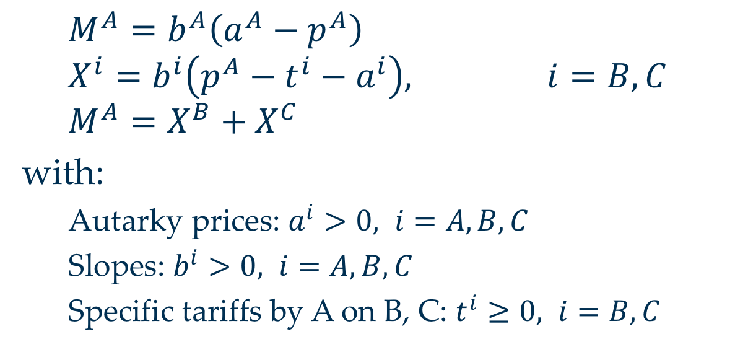
Model
$M^{A}=b^{A}\left(a^{A}−p^{A}\right)$
$$X^{i}=b^{i}\left(p^{A}−t^{i}−a^{i}\right), i=B,C$$
$$M^{A}=X^{B}+X^{C}$$
with:
Autarky prices: $a^{i}>0, i=A,B,C$
Slopes: $b^{i}>0, i=A,B,C$
Specific tariffs by A on B, C: $t^{i}≥0, i=B,C$

Slide 10
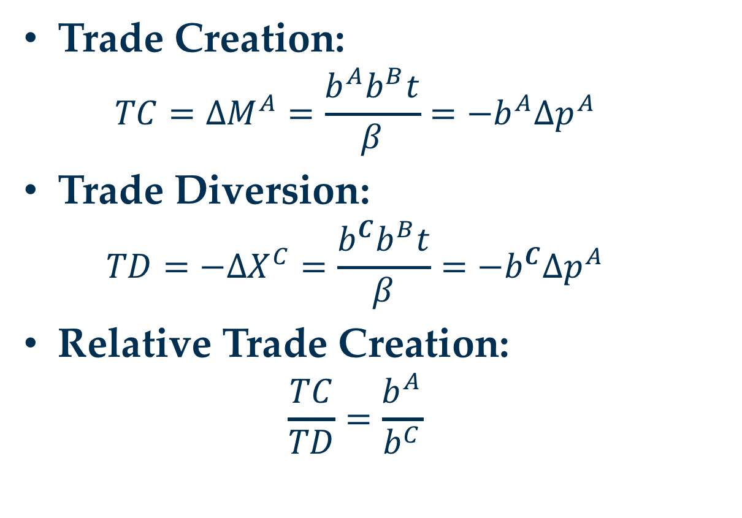
Effects of FTA
Trade Creation:
$${TC=∆M}^{A}=\frac{b^{A}b^{B}t}{β}=−b^{A}∆p^{A}$$
Trade Diversion:
$${TD=−∆X}^{C}=\frac{b^{C}b^{B}t}{β}=−b^{C}∆p^{A}$$
Relative Trade Creation:
$$\frac{TC}{TD}=\frac{b^{A}}{b^{C}}$$

Slide 11
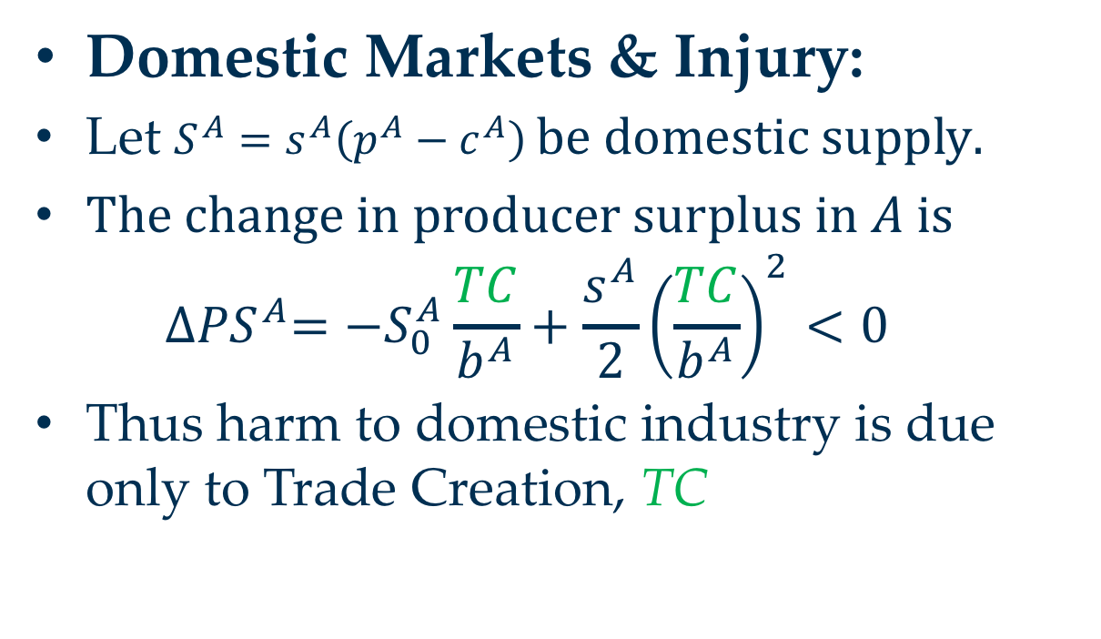
Effects of FTA on Country A
Domestic Markets & Injury:
Let $S^{A}=s^{A}\left(p^{A}−c^{A}\right) be domestic supply.$
$The change in producer surplus in A is$
$${∆PS}^{A}=−S_{0}^{A}\frac{TC}{b^{A}}+\frac{s^{A}}{2}{\left(\frac{TC}{b^{A}}\right)}^{2}<0$$
Thus harm to domestic industry is due only to Trade Creation, TC

Slide 12
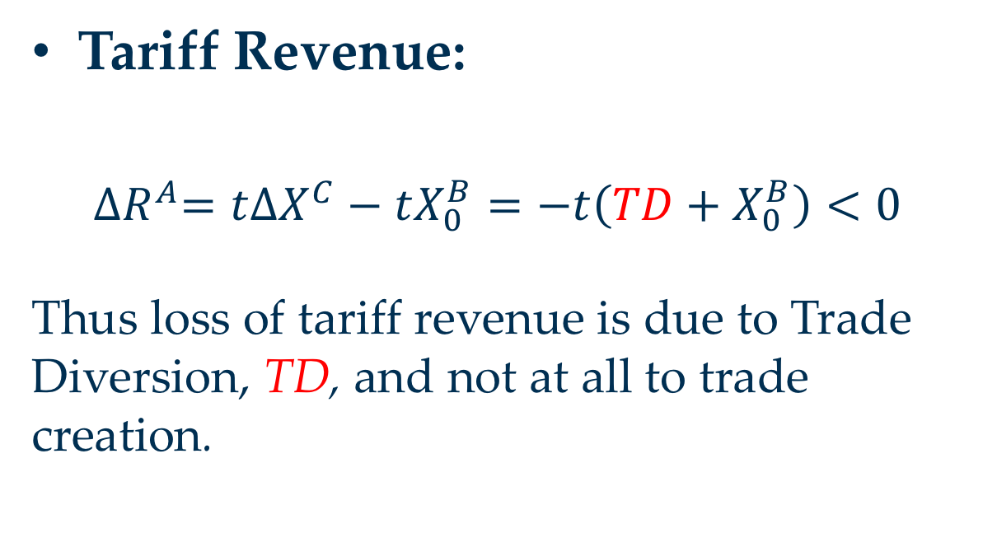
Effects of FTA on Country A
Tariff Revenue:
${∆R}^{A}=t{∆X}^{C}−tX_{0}^{B}=−t\left(TD+X_{0}^{B}\right)<0$
Thus loss of tariff revenue is due to Trade Diversion, TD, and not at all to trade creation.

Slide 13
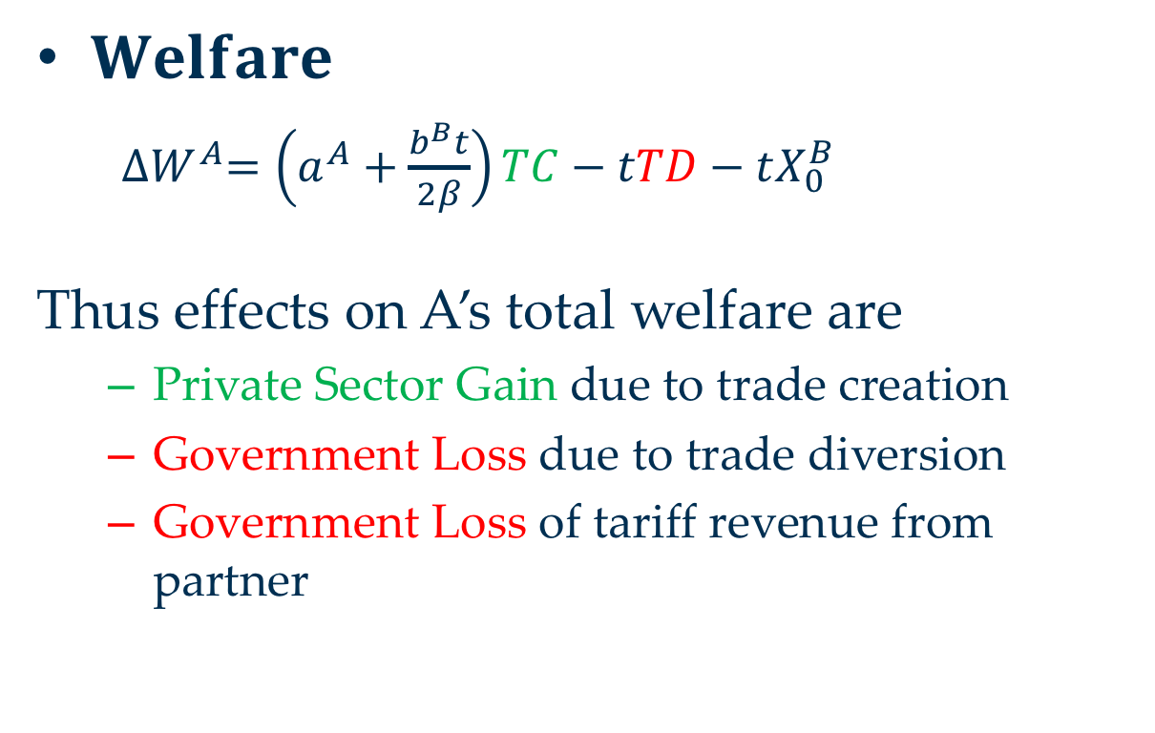
Effects of FTA on Country A
Private Sector
Gov’t
$Welfare$
${∆W}^{A}=\left(a^{A}+\frac{b^{B}t}{2β}\right)TC−tTD−tX_{0}^{B}$
Thus effects on A’s total welfare are
Private Sector Gain due to trade creation
Government Loss due to trade diversion
Government Loss of tariff revenue from partner

Slide 14
Graphical Illustration*
As with equations above,
Three countries: importer A; exporters B, and C
Export supply and import demands are linear
Countries B and C are identical
Two equilibria
0: MFN tariff t on exports of both B and C
1: FTA of A and B:
tariff t on exports of C;
zero tariff on exports of B
For simplicity
*Much of this is an elaboration of material in World Trade Organization, "Causes and Effects of PTAs: Is it all about preferences?", Ch. C: World Trade Report 2011, pp. 92-121.

Slide 15





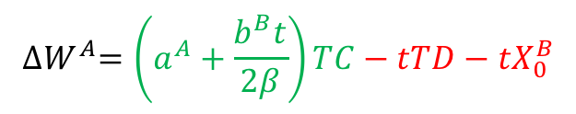









Welfare Effects on Country A
Export Supplies
Import Market
Net gain of A’s private sector
Tariff revenue lost from
B C
P
$X^{Bt}, X^{Ct}$
P
$X^{Bt}+X^{Ct}$
$X^{Bf}, X^{Cf}$
$$p_{0}^{A}$$
$X^{Bf}+X^{Ct}$
$$p_{1}^{A}$$
$$M^{A}$$
$$t$$
TD
$a^{B}=a^{C}$
TC
TC
TD
$$X_{0}^{B}$$
$$=X_{0}^{C}$$
Q
Q
$$X_{1}^{C}$$
$$X_{1}^{B}$$
$$M_{0}^{A}$$
$$M_{1}^{A}$$
$${∆W}^{A}=\left(a^{A}+\frac{b^{B}t}{2β}\right)TC−tTD−tX_{0}^{B}$$

Slide 16
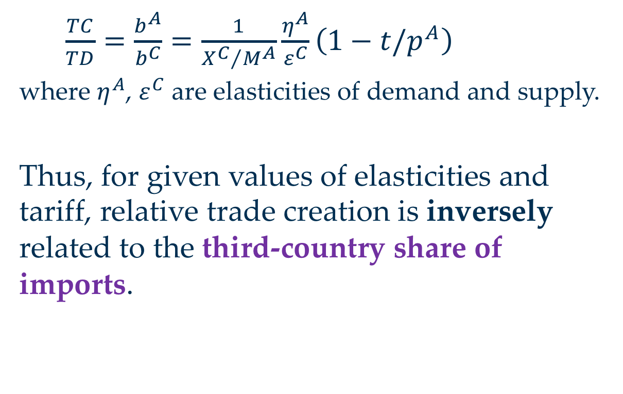
Indicator of Trade Creation/Trade Diversion
$\frac{TC}{TD}=\frac{b^{A}}{b^{C}}=\frac{1}{{X^{C}}/{M^{A}}}\frac{η^{A}}{ε^{C}}\left(1−t/p^{A}\right)$
where $η^{A}$, $ε^{C}$ are elasticities of demand and supply.
Thus, for given values of elasticities and tariff, relative trade creation is inversely related to the third-country share of imports.

Slide 17
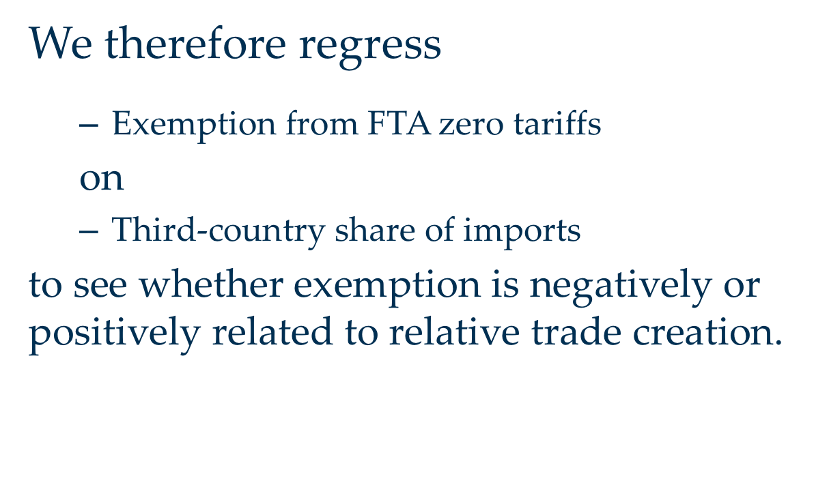
Indicator of Trade Creation/Trade Diversion
We therefore regress
Exemption from FTA zero tariffs
on
Third-country share of imports
to see whether exemption is negatively or positively related to relative trade creation.

Slide 18
Hypotheses
If FTA exemption is to avoid industry disruption, then we expect it to be
Negatively related to 3rd-country share of imports (& thus positively related to TC/TD)
If FTA exemption is to avoid lost tariff revenue, then we expect it to be
Positively related to 3rd-country share of imports (& thus negatively related to TC/TD)

Slide 19
Data
Bilateral tariffs: CEPII
Bilateral tariff rates, 6-digit HS
3-year averages 2009 – 2011
MFN tariffs: TRAINS
Trade: UNCOMTRADE via CEPII
Tariff revenue: IMF

Slide 20
Data
Coverage
37 importing countries
Mix of high-, middle-, and low-income
240 importer-exporter pairs
FTAs from
1998 or later to allow data on pre-FTA trade
2005 or earlier to give time for phasing in cuts
EU not included as importer, but does appear as exporter

Slide 21
Importing Countries
Code | Country | Code | Country
ALB | Albania | MDA | Moldolva
AUS* | Australia | MEX | Mexico
BIH | Bosnia and Herzegovina | MKD | Macedonia, Republic of
CAN* | Canada | MOZ | Mozambique
CHE* | Switzerland | MUS | Mauritius
CHL | Chile | MWI | Malawi
CRI | Costa Rica | MYS | Malaysia
DOM | Domminican Republic | NIC | Nicaragua
DZA | Algeria | NOR* | Norway
GTM | Guatemala | NZL* | New Zealand
HND | Honduras | PAN | Panama
HRV | Croatia | PHL | Philippines
IDN | Indonesia | SLV | El Salvador
IND | India | SRB | Serbia
ISR* | Israel | UKR | Ukraine
JPN* | Japan | USA* | United States of America
KOR* | South Korea | VNM | Viet Nam
LKA | Sri Lanka | ZMB | Zambia
MAR | Morocco
Table 1: Descriptive Statistics
*High Income

Slide 22
Descriptive Statistics
Importer | Fraction Exempted Products | # of Part-ners | Earliest FTA | Latest FTA | Importer | Fraction Exempted Products | # of Part-ners | Earliest FTA | Latest FTA
ALB | 0.09 | 7 | 2002 | 2004 | MAR | 0.11 | 14 | 1998 | 1999
AUS* | 0.24 | 2 | 2005 | 2005 | MDA | 0.11 | 4 | 2004 | 2004
BIH | 0.15 | 5 | 2002 | 2004 | MEX | 0.06 | 28 | 1998 | 2004
CAN* | 0.06 | 1 | 2002 | 2002 | MKD | 0.30 | 28 | 2000 | 2004
CHE* | 0.10 | 9 | 1999 | 2005 | MOZ | 0.06 | 7 | 2000 | 2000
CHL | 0.05 | 26 | 2002 | 2004 | MUS | 0.06 | 3 | 2000 | 2001
CRI | 0.24 | 3 | 2002 | 2002 | MWI | 0.03 | 1 | 2000 | 2000
DOM | 0.09 | 5 | 2001 | 2002 | MYS | 0.28 | 1 | 1999 | 1999
DZA | 0.06 | 14 | 1998 | 1999 | NIC | 0.07 | 2 | 1998 | 2002
GTM | 0.14 | 2 | 2001 | 2001 | NOR* | 0.24 | 9 | 1999 | 2005
HND | 0.14 | 2 | 2001 | 2001 | NZL* | 0.16 | 2 | 2001 | 2005
HRV | 0.11 | 30 | 1998 | 2004 | PAN | 0.26 | 2 | 2003 | 2004
IDN | 0.01 | 1 | 1999 | 1999 | PHL | 0.44 | 1 | 1999 | 1999
IND | 0.20 | 1 | 2001 | 2001 | SLV | 0.28 | 3 | 2001 | 2003
ISR* | 0.14 | 9 | 1998 | 2004 | SRB | 0.16 | 5 | 2004 | 2004
JPN* | 0.20 | 2 | 2002 | 2005 | UKR | 0.18 | 1 | 2001 | 2001
KOR* | 0.19 | 1 | 2004 | 2004 | USA* | 0.10 | 3 | 2001 | 2005
LKA | 0.21 | 2 | 2001 | 2005 | VNM | 0.43 | 1 | 1999 | 1999
MAR | 0.11 | 14 | 1998 | 1999 | ZMB | 0.23 | 3 | 2000 | 2001
MDA | 0.11 | 4 | 2004 | 2004
Table 1: Descriptive Statistics

Slide 23
Data
Note range of
Exempted sectors:
1% for Indonesia to 44% for Philippines
Sample mean: 16%
Number of FTA partners
1 for several, including US
26-30 for Chile, Croatia, Mexico, Macedonia
(Countries can have different tariffs on different EU exporters; results the same without them)
Sample mean: 6.5; median 3

Slide 24
Results
Table 2: Baseline Regressions
 | (1) | (2) | (3) | (4) | (5) | (6)
 | Dependent Variable: Exempted Product Indicator
Third country share | 0.065*** | -0.195*** | 0.076***
 | (0.007) | (0.032) | (0.007)
Third country share (combined) |  |  |  | 0.056*** | -0.177*** | 0.060***
 |  |  |  | (0.008) | (0.033) | (0.008)
Observations | 112,378 | 34,796 | 77,582 | 243,822 | 38,654 | 205,168
R-squared | 0.209 | 0.074 | 0.259 | 0.19 | 0.076 | 0.207
Imp-Exp FE | Yes | Yes | Yes | Yes | Yes | Yes
Sample | All | High Inc. | Not High Inc. | All | High Inc. | Not High Inc.
Importer-product clustered standard errors
*** p<0.01, ** p<0.05, * p<0.1

Slide 25
Results
Implications of Table 2:
High-income countries exempt products where there would have been trade creation
Not-high-income countries exempt products where there would have been trade diversion
Thus lower-income countries’ FTAs are more likely net beneficial

Slide 26
Table 3: Regressions with Interaction Terms
 | (1) | (2) | (3) | (4) | (5)
 | Dependent Variable: Exempted Product Indicator
Third country share (3S) | 0.076*** | 0.068*** | 0.034*** | 0.002 | -0.037***
 | (0.007) | (0.008) | (0.008) | (0.008) | (0.010)
3S x high income | -0.271*** | -0.264*** | -0.244*** | -0.245*** | -0.225***
 | (0.032) | (0.033) | (0.032) | (0.032) | (0.032)
3S x high tariff reliance |  | 0.029** |  |  | 0.077***
 |  | (0.015) |  |  | (0.016)
3S x high inc. partner |  |  | 0.066*** |  | 0.065***
 |  |  | (0.012) |  | (0.015)
3S x exporter larger |  |  |  | 0.105*** | 0.077***
 |  |  |  | (0.011) | (0.013)
Observations | 112,378 | 112,378 | 112,378 | 111,603 | 111,603
R-squared | 0.210 | 0.210 | 0.210 | 0.212 | 0.212
Importer-Exporter FE | Yes | Yes | Yes | Yes | Yes
Sample | All | All | All | All | All
Importer-product clustered standard errors
*** p<0.01, ** p<0.05, * p<0.1

Slide 27
Results
Implications of Table 3:
As in Table 2, high-income countries exempt sensitive sectors (TC)
Countries exempt trade-diverting (TD) sectors if
They rely on tariff revenue
They import from high income partners
They import from larger partners

Slide 28
Table 4: Regressions with Product Fixed Effects
 | (1) | (2) | (3) | (4)
 | Dependent Variable: Excluded Product Indicator
Third country share (3S) | 0.053*** | -0.133*** | 0.062*** | -0.025***
 | (0.006) | (0.028) | (0.006) | (0.010)
3S x high income |  |  |  | -0.177***
 |  |  |  | (0.028)
3S x high tariff reliance |  |  |  | 0.056***
 |  |  |  | (0.015)
3S x high inc. partner |  |  |  | 0.048***
 |  |  |  | (0.014)
3S x exporter larger |  |  |  | 0.060***
 |  |  |  | (0.012)
Observations | 112,295 | 34,425 | 77,366 | 111,521
R-squared | 0.399 | 0.410 | 0.446 | 0.403
Importer-Exporter FE | Yes | Yes | Yes | Yes
Product FE | Yes | Yes | Yes | Yes
Sample | All | High Income | Not High Income | All
*** p<0.01, ** p<0.05, * p<0.1
Standard errors are clustered at the importer-product level

Slide 29
Conclusions
Exempted products from FTAs are common
In developed countries, they tend to be in “sensitive sectors,” thus limiting trade creation and the benefits of FTAs
In poorer countries they tend to be where there would have been trade diversion due to concern for
Tariff revenue
Pressure from stronger FTA partners
Exemptions are thus more likely beneficial

